Slide 1

Lake Elsinore and Canyon Lake TMDL Water Quality Monitoring Update – 2016-17 Summary
August 15, 2017

Slide 2
Lake Elsinore and Canyon Lake TMDL Water Quality Monitoring Update – 2016-17 Summary
Watershed Monitoring

Slide 3

Summary of 2016-2017 Watershed Monitoring and Nutrient Loads
Number and Location Description | Annual Flow (Mgal) | Annual Event Mean Storm Concentration (mg/L) |  | Estimated Annual Load (kg)
 |  | Total Nitrogen | Total Phosphorus | Total Nitrogen | Total Phosphorus
Site 3 - Salt Creek at Murrieta Road | 1,596 | 2.07 | 0.62 | 12,366 | 4,026
Site 4 - San Jacinto River at Goetz | 2,802 | 2.03 | 1.23 | 21,651 | 14,403
Site 6 - San Jacinto River at Ramona Expressway | 0 | - | - | - | -
Site 30 - Canyon Lake Spillway | 4,850 | 1.85 | 0.36 | 33,759 | 6,637
Site 1 - San Jacinto River at Cranston Guard Station | 6,194 | Not Measured | Not Measured | Not Measured | Not Measured

Slide 4
Summary of 2016-2017 Monthly Flow
Mean Monthly Flow (cfs) | Site 3 - Salt Creek | Site 4 - San Jacinto River | Site 6 - San Jacinto River at Ramona Expressway | Site 30 - Canyon Lake Spillway | Site 1 - San Jacinto River at Cranston Guard Station
July | 0.00 | 0.00 | - | 3.10 | 0.05
August | 0.00 | 0.00 | - | 2.89 | 0.03
September | 0.00 | 0.00 | - | 0.16 | 0.01
October | 0.17 | 0.00 | - | 0.15 | 0.02
November | 3.67 | 3.01 | - | 0.67 | 0.05
December | 23.51 | 32.95 | - | 25.80 | 14.41
January | 43.55 | 90.61 | - | 176.06 | 72.75
February | 9.01 | 14.48 | - | 25.04 | 125.53
March | 0.73 | 0.31 | - | 6.39 | 86.86
April | 0.00 | 0.00 | - | 1.03 | 15.60
May | 0.00 | 0.00 | - | 2.98 | 5.71
June | 0.00 | 0.00 | - | 0.27 | 0.84
Mean Annual Flow (cfs) | 6.98 | 12.26 | - | 20.56 | 27.77

Slide 5
Summary of 2016-2017 Rainfall
Monthly Rainfall (inches) | Lake Elsinore | Perris CDF | Pigeon Pass | Hemet / San Jacinto | Winchester
Jul | 0.00 | 0.00 | 0.00 | 0.00 | 0.00
Aug | 0.00 | 0.00 | 0.00 | 0.00 | 0.00
Sep | 0.08 | 0.08 | 0.00 | 0.16 | 0.12
Oct | 0.24 | 0.35 | 0.78 | 0.34 | 0.28
Nov | 0.98 | 0.90 | 1.35 | 1.09 | 1.03
Dec | 3.60 | 3.21 | 3.94 | 3.20 | 3.17
Jan | 6.68 | 6.04 | 6.78 | 6.23 | 4.86
Feb | 3.02 | 2.06 | 2.61 | 2.86 | 2.31
Mar | 0.03 | 0.02 | 0.16 | 0.21 | 0.06
Apr | 0.02 | 0.00 | 0.02 | 0.00 | 0.00
May | 0.27 | 0.06 | 0.26 | 0.25 | 0.08
Jun | 0.00 | 0.00 | 0.00 | 0.00 | 0.02
Annual Rainfall (Inches) | 14.92 | 12.72 | 15.90 | 14.34 | 11.93

Slide 6
2016-2017 Annual Hydrograph

Slide 7
2016-2017 Annual Hydrograph

Slide 8
2016-2017 Annual Hydrograph

Slide 9
2016-2017 Annual Hydrograph

Slide 10
2016-2017 Annual Hydrograph

Slide 11
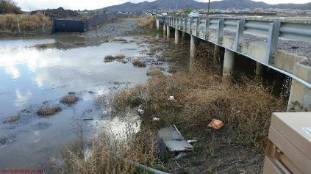
Wet Event #1
December 16-18, 2016
Rainfall: 0.43 to 0.78 inches
Sites: Salt Creek and San Jacinto

Slide 12
Wet Event #2
January 19-22, 2017
Rainfall: 1.32 to 2.0 inches
Sites: Salt Creek, San Jacinto, and Canyon Lake

Slide 13
Wet Event #3
February 17-20, 2017
Rainfall: 0.97 to 1.66 inches
Sites: Salt Creek, San Jacinto, and Canyon Lake

Slide 14
Summary of 2008-2017 Nutrient Concentrations
Monitoring Year | Site 3 - Salt Creek |  | Site 4 - San Jacinto River |  | Site 30 - Canyon Lake Spillway
 | TN (mg/L) | TP (mg/L) | TN (mg/L) | TP (mg/L) | TN (mg/L) | TP (mg/L)
2008-2009* | 3.0/3.1 | 0.8/1.3 | 1.4/3.1 | 0.7/1.5 | NS | NS
2009-2010* | 1.5/1.9 | 0.6/1.0 | 1.6/3.2 | 0.5/1.2 | 0.7/1.3 | 0.6/0.8
2010-2011* | 1.5/2.2 | 0.4/0.5 | 1.4/2.2 | 0.7/1.9 | 0.9/1.5 | 0.5/0.9
2011-2012 | 1.9 | 0.3 | 2.2 | 0.5 | NS | NS
2012-2013 | 1.9 | 0.3 | 2.1 | 0.5 | NS | NS
2013-2014 | 2.7 | 0.9 | 1.8 | 0.6 | NS | NS
2014-2015 | 2.2 | 0.5 | 1.8 | 0.4 | NS | NS
2015-2016 | 2.5 | 0.5 | 2.4 | 1.4 | NS | NS
2016-2017 | 2.1 | 0.6 | 2.0 | 1.2 | 1.9 | 0.4
*Values shown for nutrient concentrations are minimum/maximum NS-Not sampled

Slide 15
Summary of 2008-2017 Nutrient Loads
Monitoring Year | Site 3 - Salt Creek |  |  | Site 4 - San Jacinto River |  |  | Site 30 - Canyon Lake Spillway
 | Flow (Mgal) | TN (kg) | TP (kg) | Flow (Mgal) | TN (kg) | TP (kg) | Flow (Mgal) | TN (kg) | TP (kg)
2008-2009* | 529 | 6,085/6,125 | 1,541/2,642 | 1,042 | 5,323/12,145 | 2,682/5,954 | NA | NS | NS
2009-2010* | 1,282 | 7,474/9,180 | 2,960/4,804 | 2,681 | 14,716/32,680 | 4,668/12,382 | 62 | 167/294 | 137/188
2010-2011* | 1,946 | 5,112/7,484 | 1,370/1,704 | 3,269 | 7,690/12,124 | 4,041/10,664 | 1,302 | 2,035/3,556 | 1,029/2,102
2011-2012 | 249 | 1,843 | 238 | 277 | 2,338 | 542 | 133 | NS | NS
2012-2013 | 147 | 1,025 | 180 | 424 | 3,341 | 822 | 114 | NS | NS
2013-2014 | 411 | 4,268 | 1,409 | 484 | 3,252 | 1,178 | 148 | NS | NS
2014-2015 | 511 | 4,661 | 1,257 | 570 | 3,932 | 1,041 | 196 | NS | NS
2015-2016 | 515 | 5,647 | 1,447 | 872 | 7,926 | 4,624 | 476 | NS | NS
2016-2017 | 1,596 | 12,366 | 4,026 | 2,802 | 21,651 | 14,403 | 4,850 | 33,759 | 6,637
*Values shown for nutrient loads are minimum/maximum NS-Not Sampled NA-Not Available

Slide 16

Lake Elsinore and Canyon Lake TMDL Water Quality Monitoring Update – 2016-17 Summary
In-Lake Monitoring

Slide 17
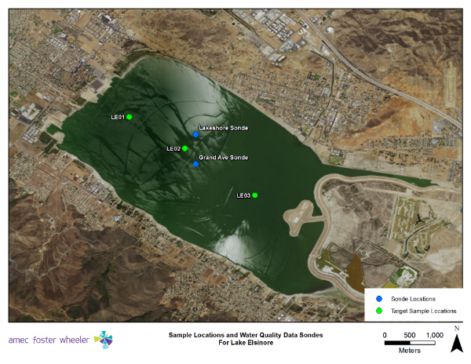
Station Locations – Lake Elsinore

Slide 18
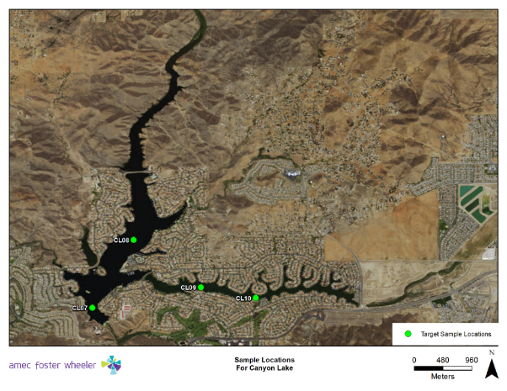
Station Locations – Canyon Lake

Slide 19

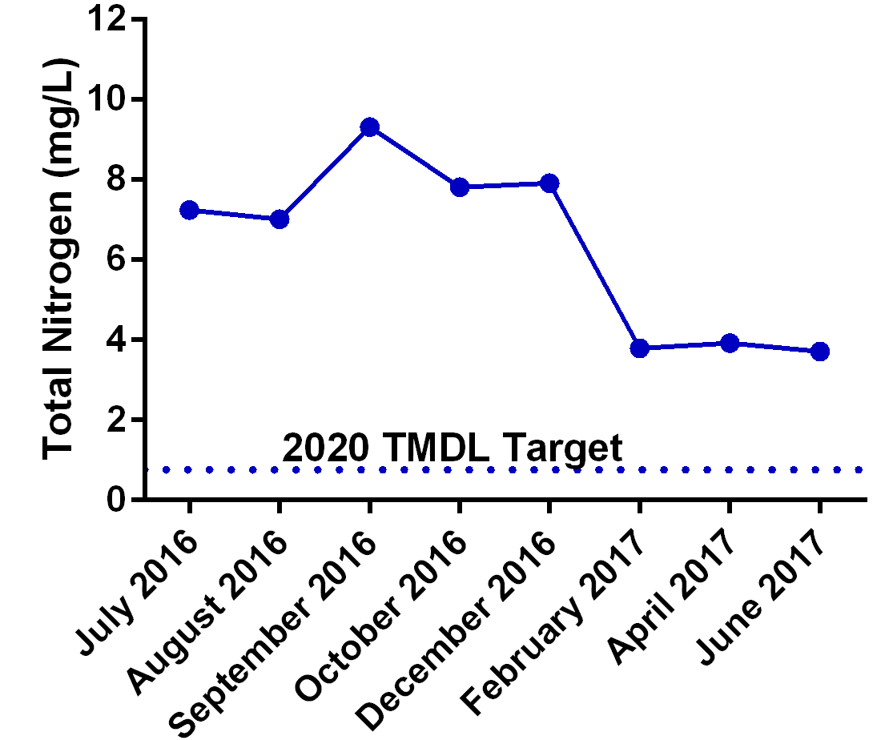
Total Nitrogen – Lake Elsinore 2016-2017

Slide 20
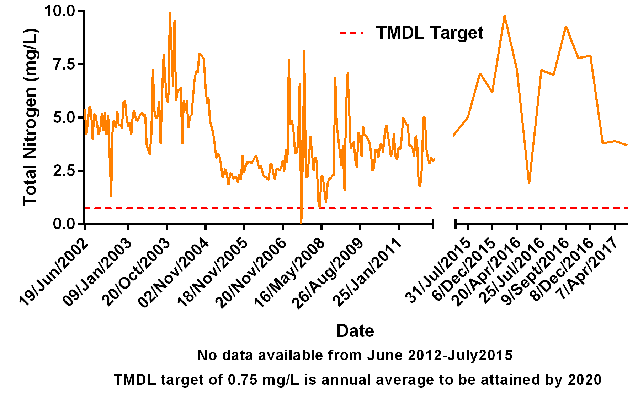
Total Nitrogen – Lake Elsinore Historic Data

Slide 21
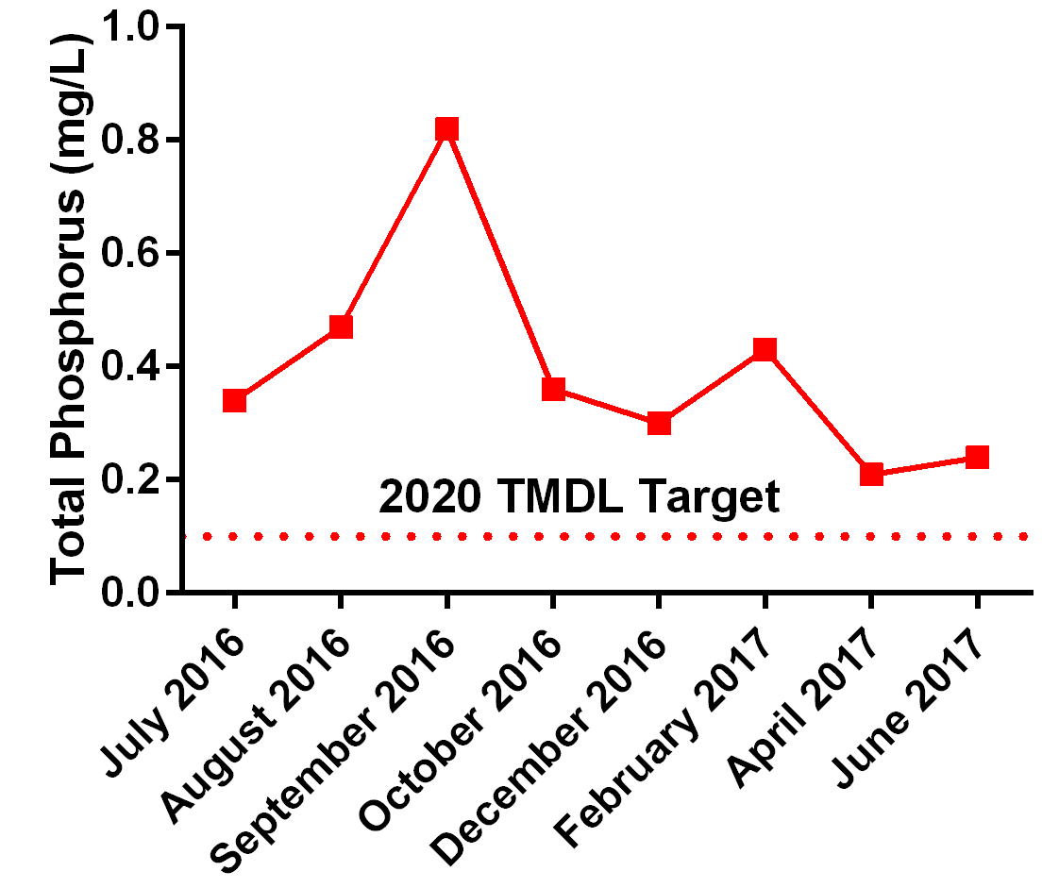
Total Phosphorus – Lake Elsinore 2016-2017

Slide 22
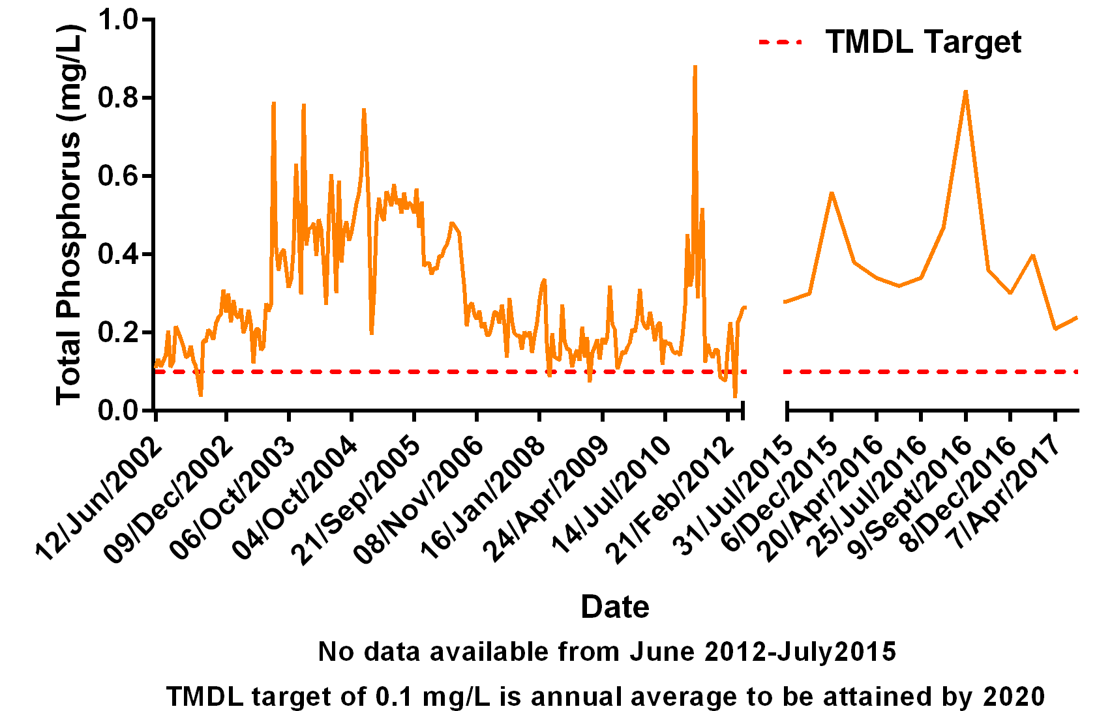
Total Phosphorus – Lake Elsinore Historic Data

Slide 23
Total Dissolved Solids– Lake Elsinore 2016-2017

Slide 24
Total Dissolved Solids– Lake Elsinore Historic Data

Slide 25
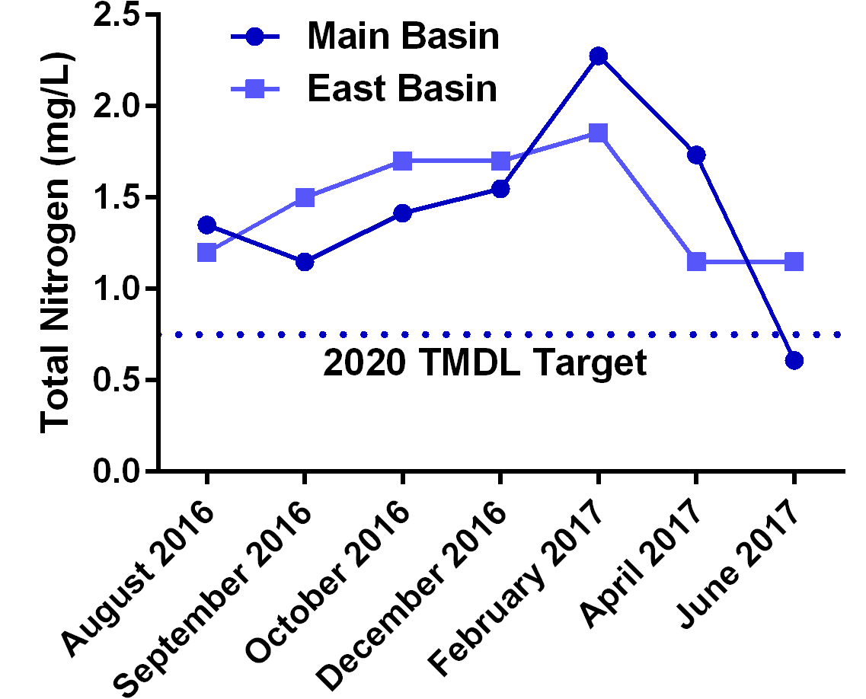
Total Nitrogen – Canyon Lake 2016-2017

Slide 26
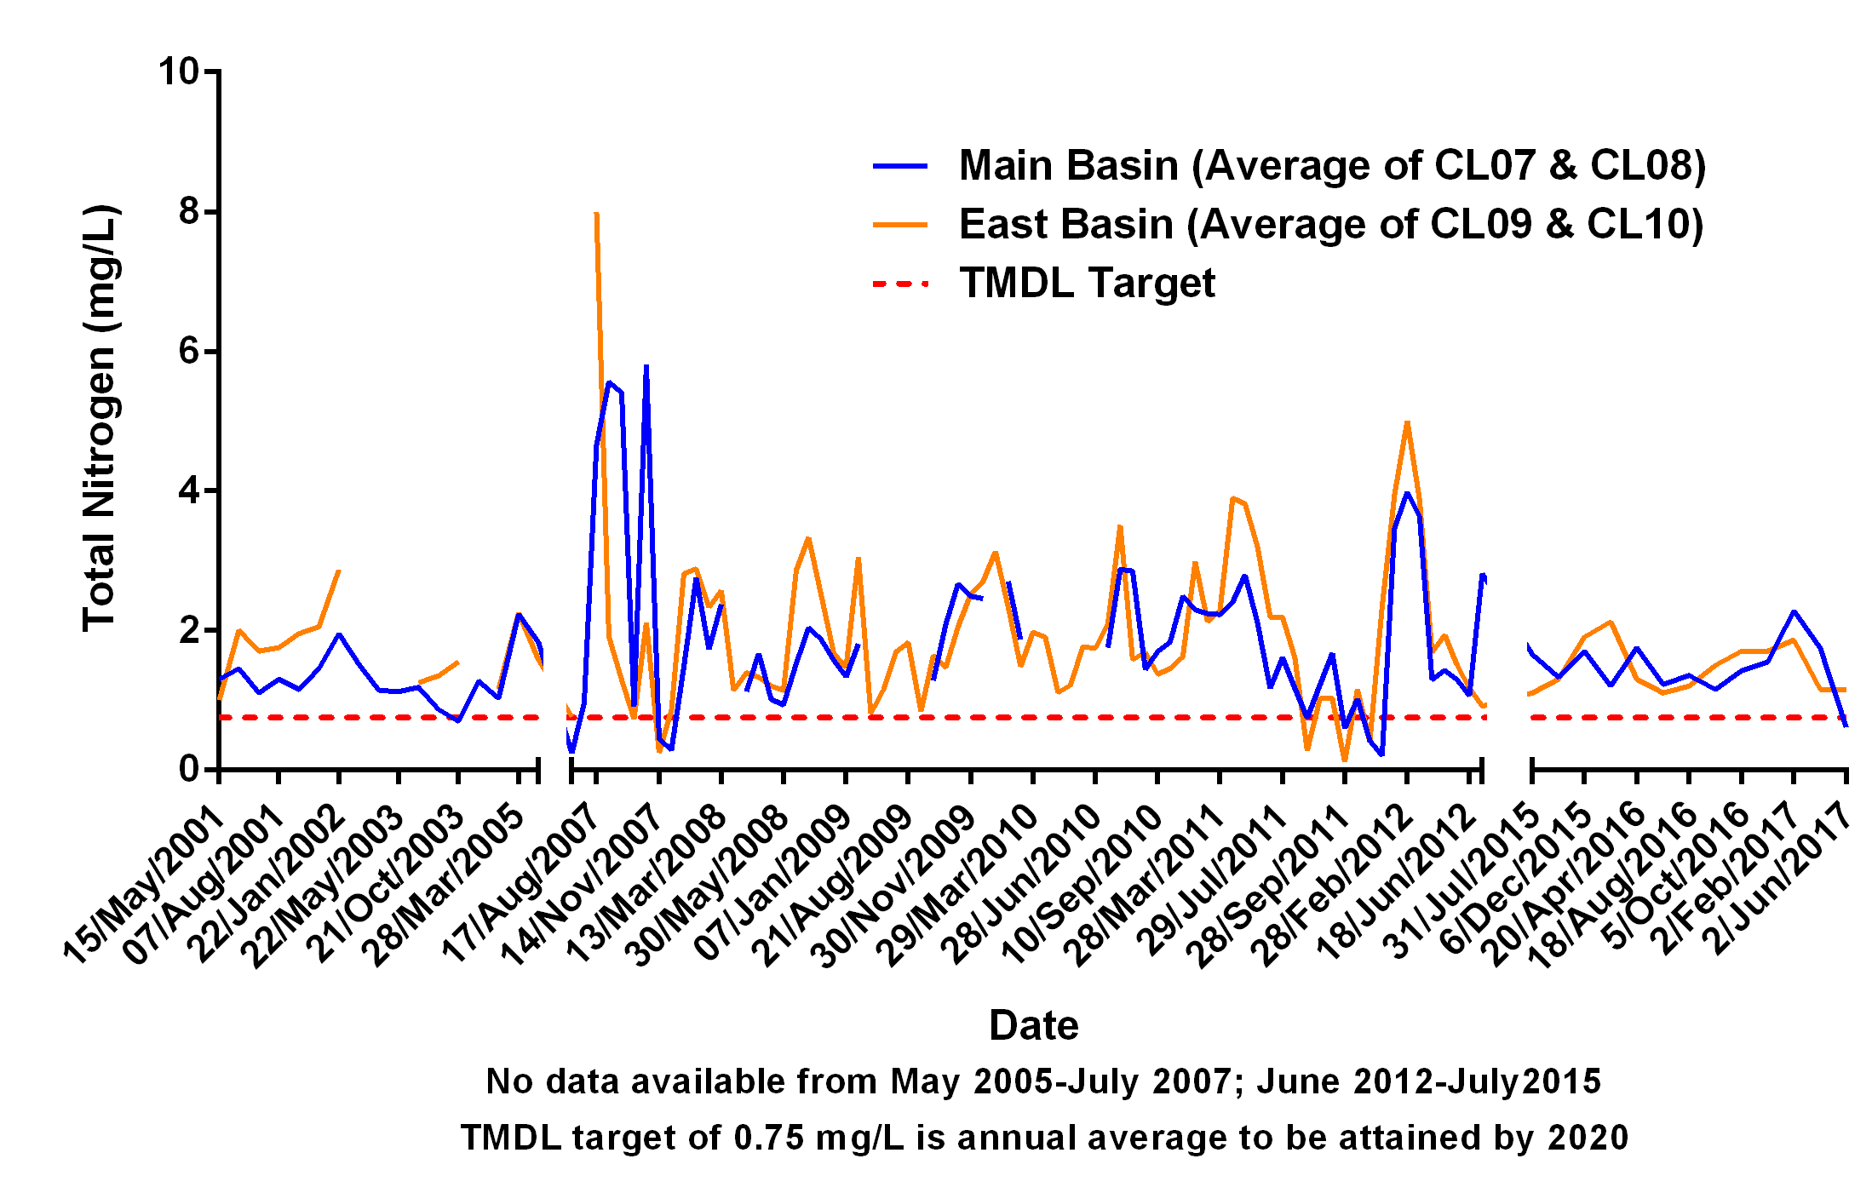
Total Nitrogen – Canyon Lake Historic Data

Slide 27
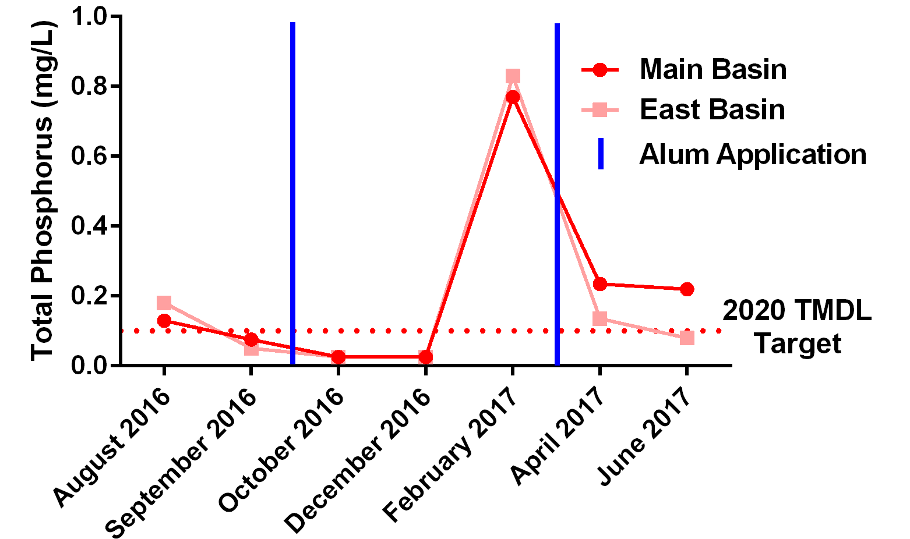
Total Phosphorus – Canyon Lake 2016-2017

Slide 28
Total Phosphorus – Canyon Lake Historic Data

Slide 29
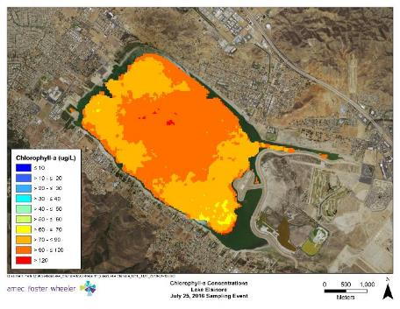
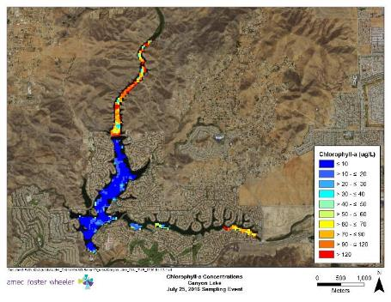
Satellite Imagery – Chlorophyll July 2016
Lake Elsinore
Canyon Lake
**Data gaps in eastern arm due to high cirrus clouds

Slide 30
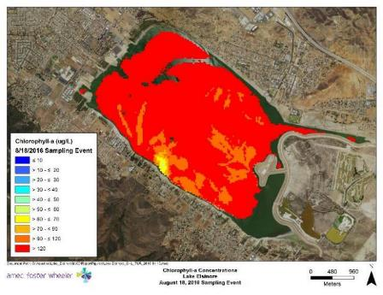
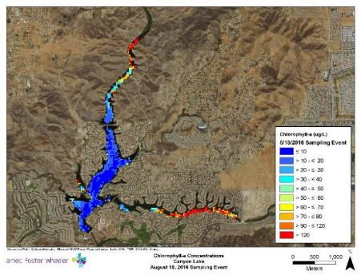
Satellite Imagery – Chlorophyll August 2016
Lake Elsinore
Canyon Lake
**Data gaps due to large floating cyanobacterial slicks

Slide 31
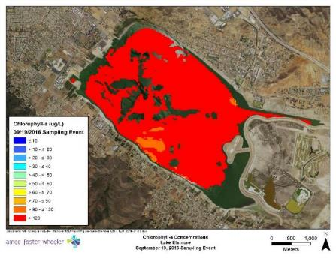

Satellite Imagery – Chlorophyll September 2016
Lake Elsinore
Canyon Lake
**Data gaps due to large floating cyanobacterial slicks

Slide 32
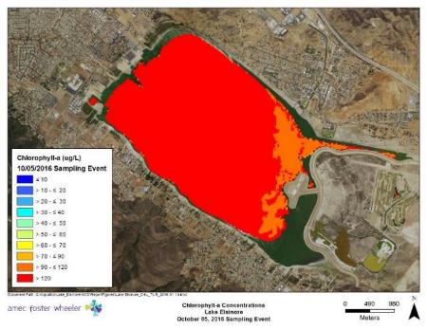
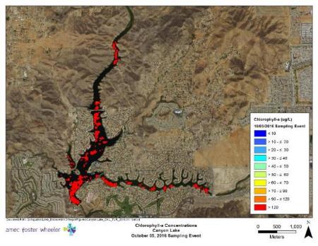
Satellite Imagery – Chlorophyll October 2016
Lake Elsinore
Canyon Lake
**Data gaps in eastern arm due to high cirrus clouds

Slide 33
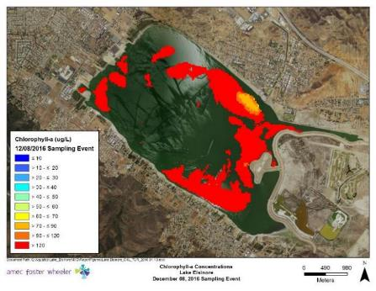
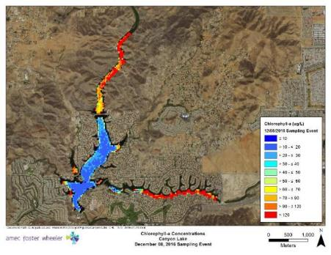
Satellite Imagery – Chlorophyll December 2016
Lake Elsinore
Canyon Lake
**Data gaps due to large floating cyanobacterial slicks

Slide 34
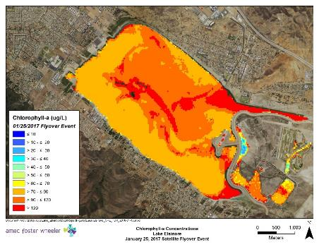
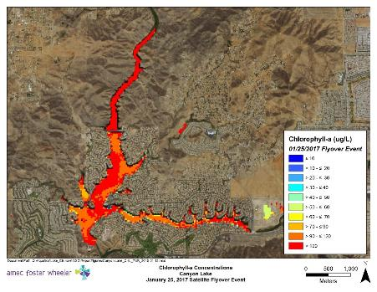
Satellite Imagery – Chlorophyll February 2017
Lake Elsinore
Canyon Lake
**High chlorophyll-a readings in Canyon Lake due to turbidity interference

Slide 35
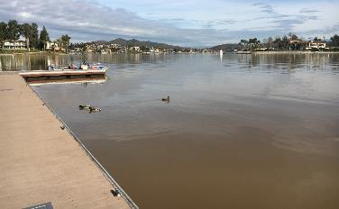
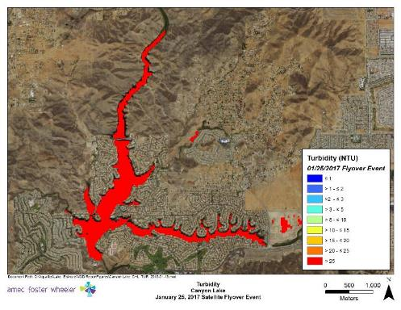
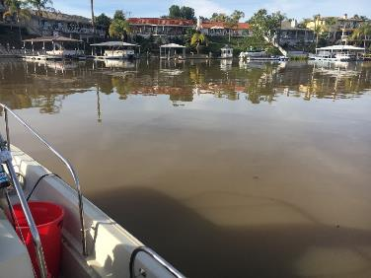
Satellite Imagery – Turbidity after January Storms
Canyon Lake

Slide 36
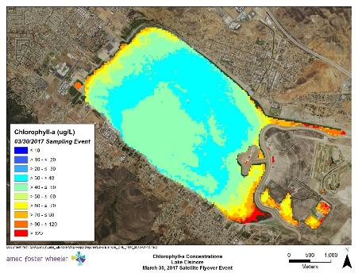
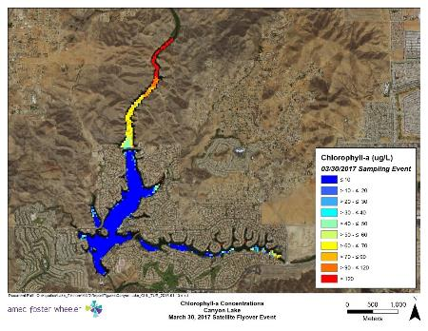
Satellite Imagery – Chlorophyll April 2017
Lake Elsinore
Canyon Lake

Slide 37
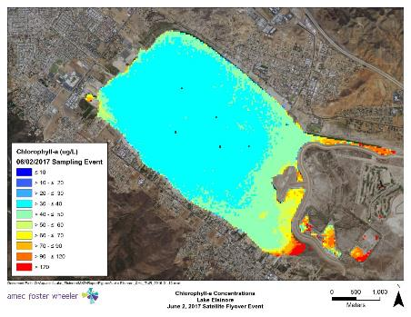
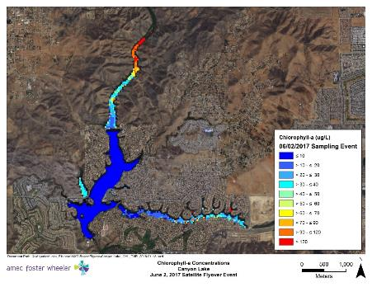
Satellite Imagery – Chlorophyll June 2017
Lake Elsinore
Canyon Lake

Slide 38
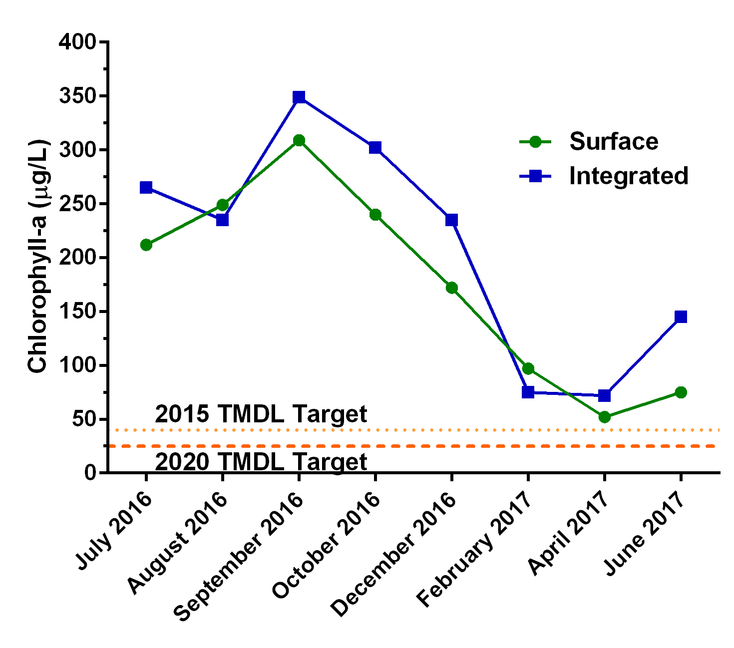
Lake Elsinore Chlorophyll – 2016-2017

Slide 39
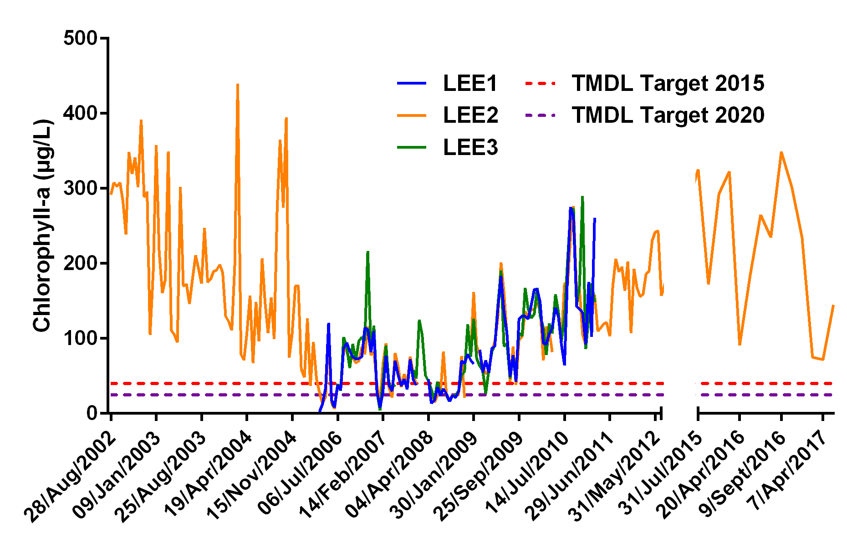
Lake Elsinore Chlorophyll – Integrated Historic Data

Slide 40
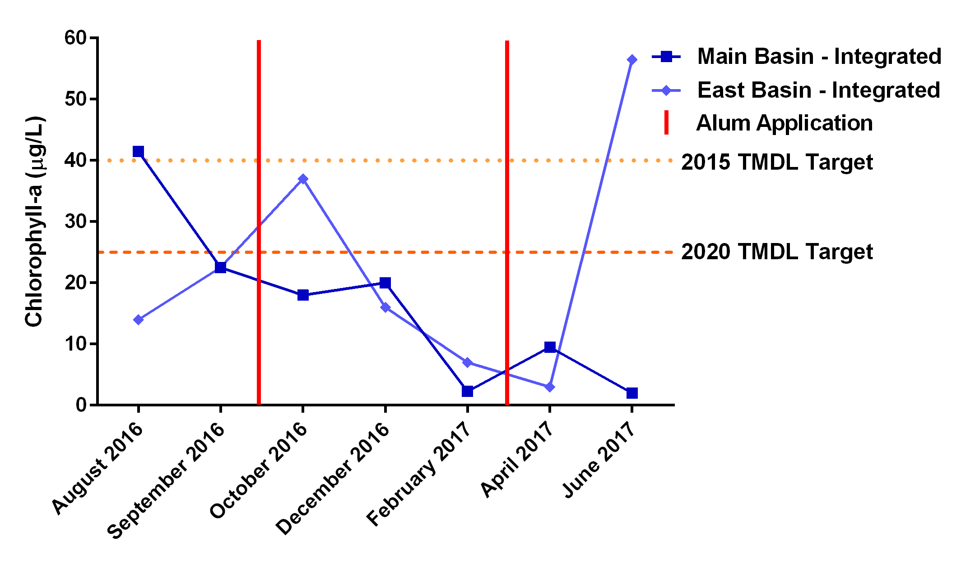
Canyon Lake Chlorophyll – 2016-2017

Slide 41
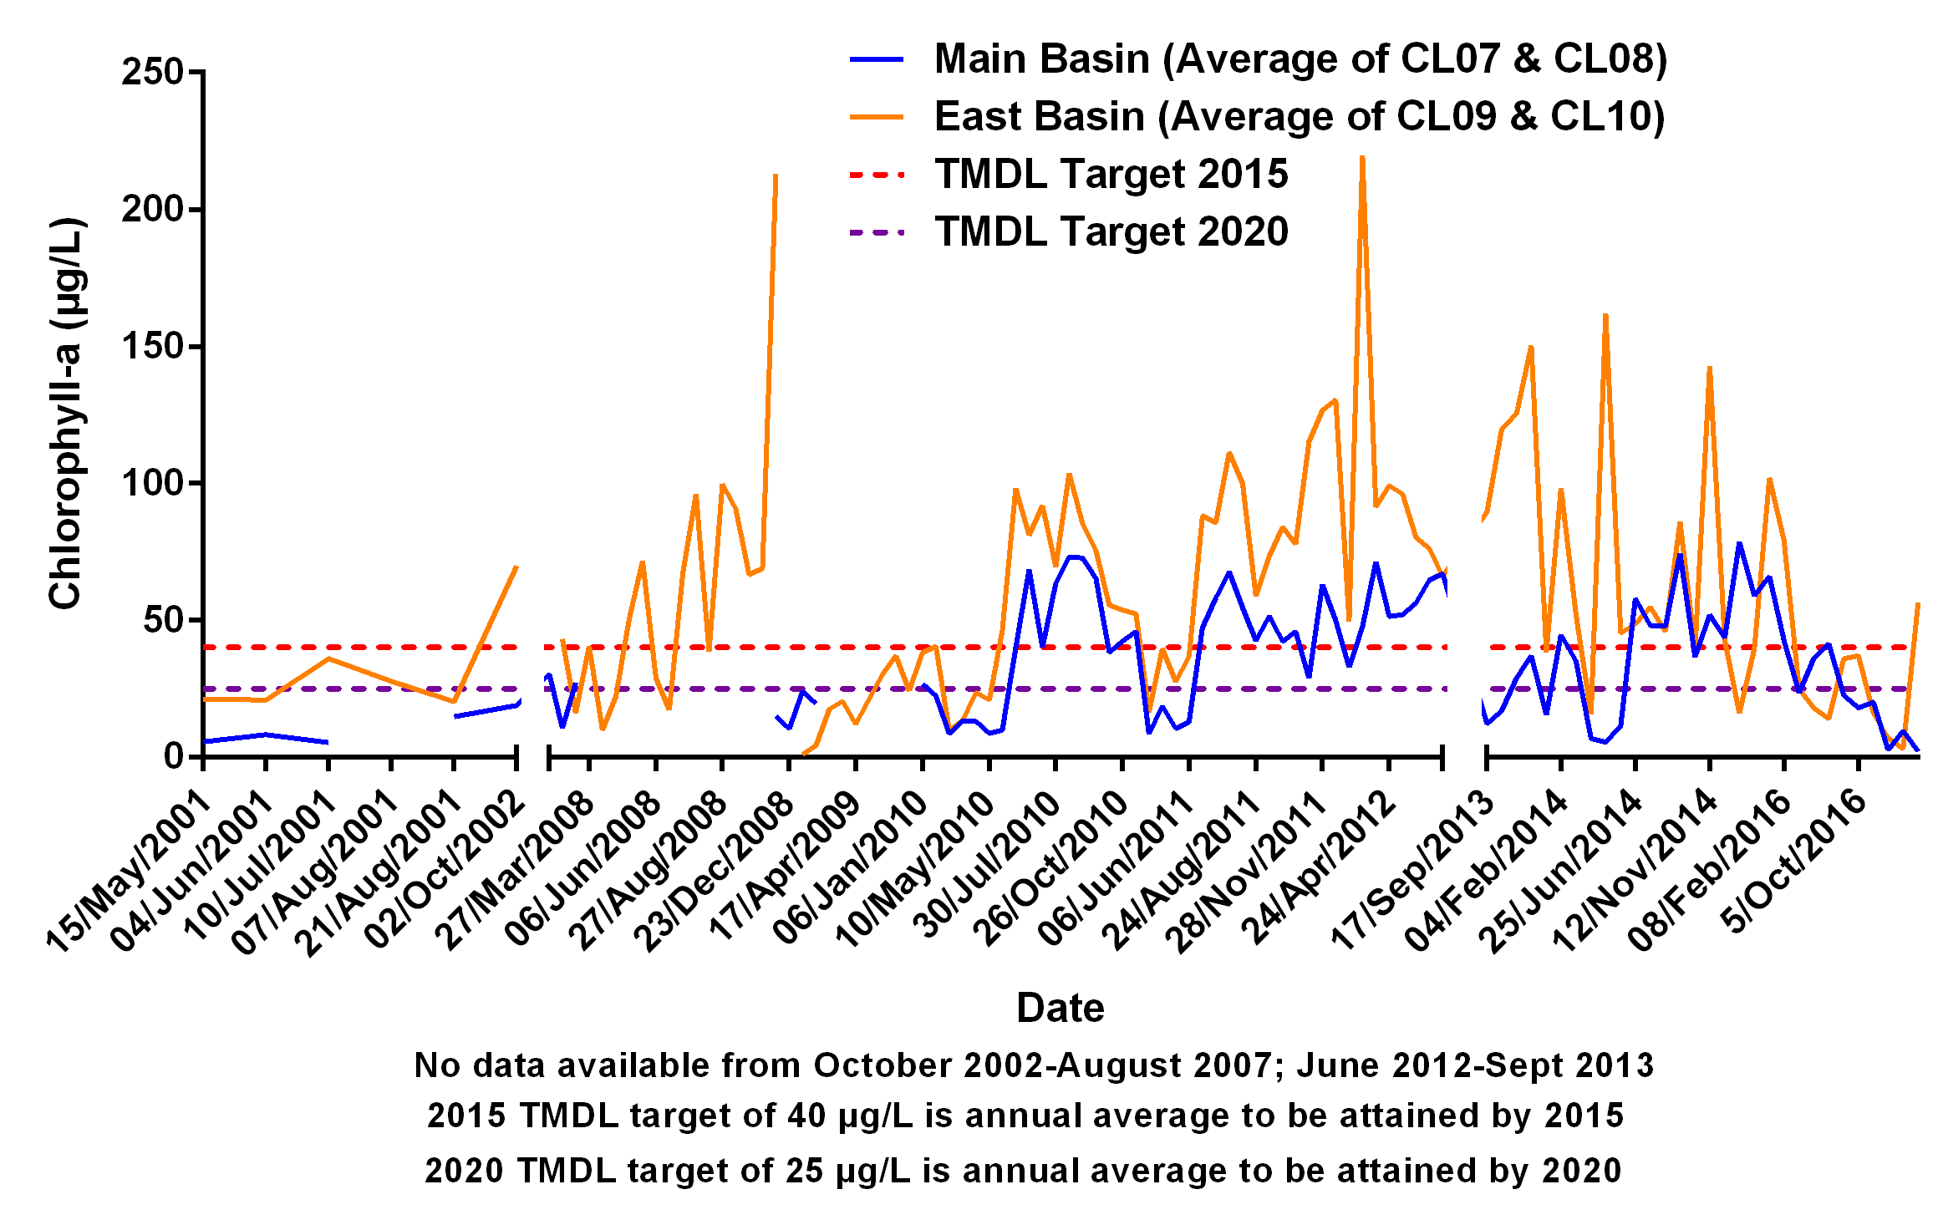
Canyon Lake Chlorophyll – Integrated Historic Data

Slide 42
Lake Elsinore and Canyon Lake TMDL Water Quality Monitoring Update – 2016-17 Summary
Dissolved Oxygen Monitoring

Slide 43
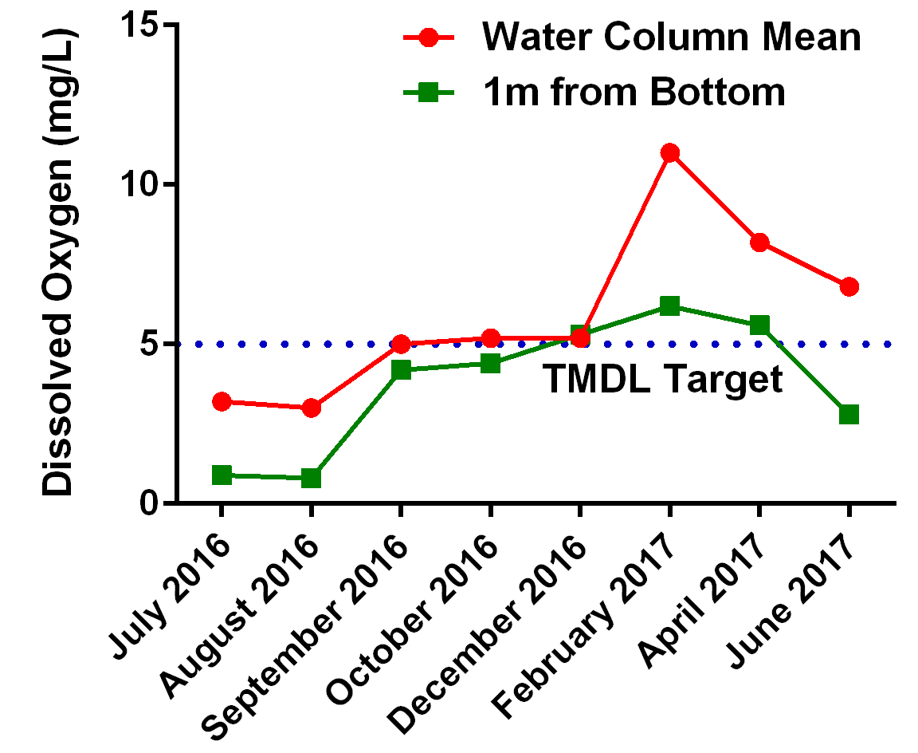
Lake Elsinore Dissolved Oxygen – LE02 Water Column Mean vs. 1m from Bottom 2016-2017

Slide 44
Lake Elsinore Dissolved Oxygen – LE02 Water Column Mean Historic Data

Slide 45
Lake Elsinore Dissolved Oxygen – LE02 1m from Bottom Historic Data

Slide 46
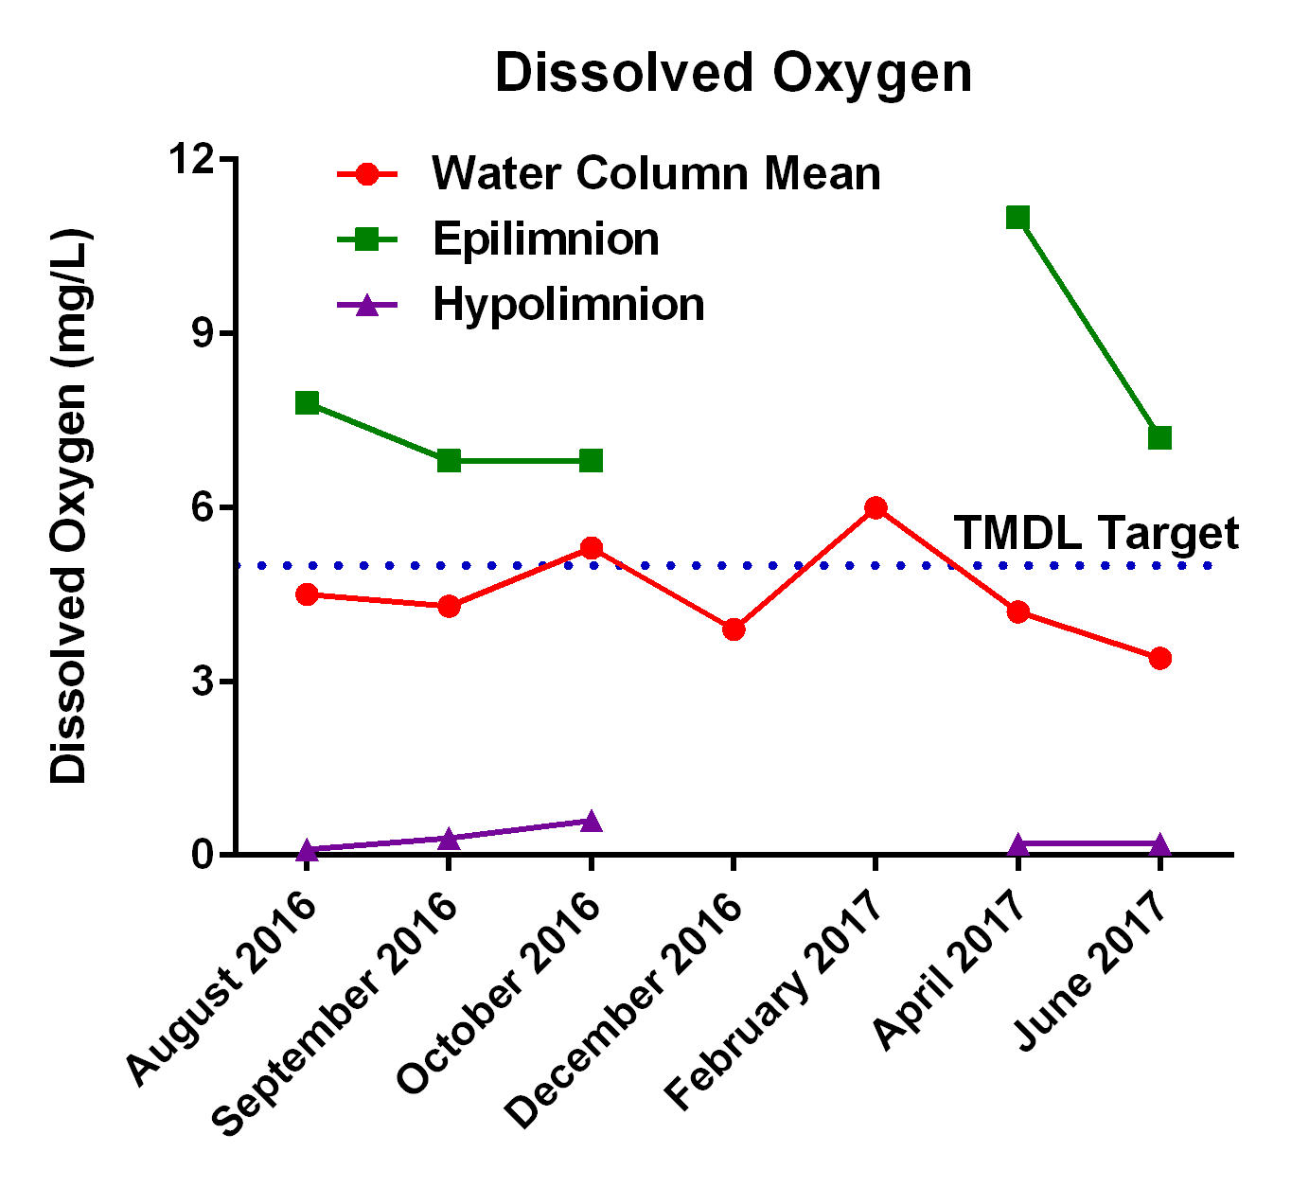
Canyon Lake Dissolved Oxygen – Main Basin Epilimnion vs. Hypolimnion 2016-2017
Mean of Sites CL07 & CL08
No stratification in December-February
Not sampled in July 2016

Slide 47
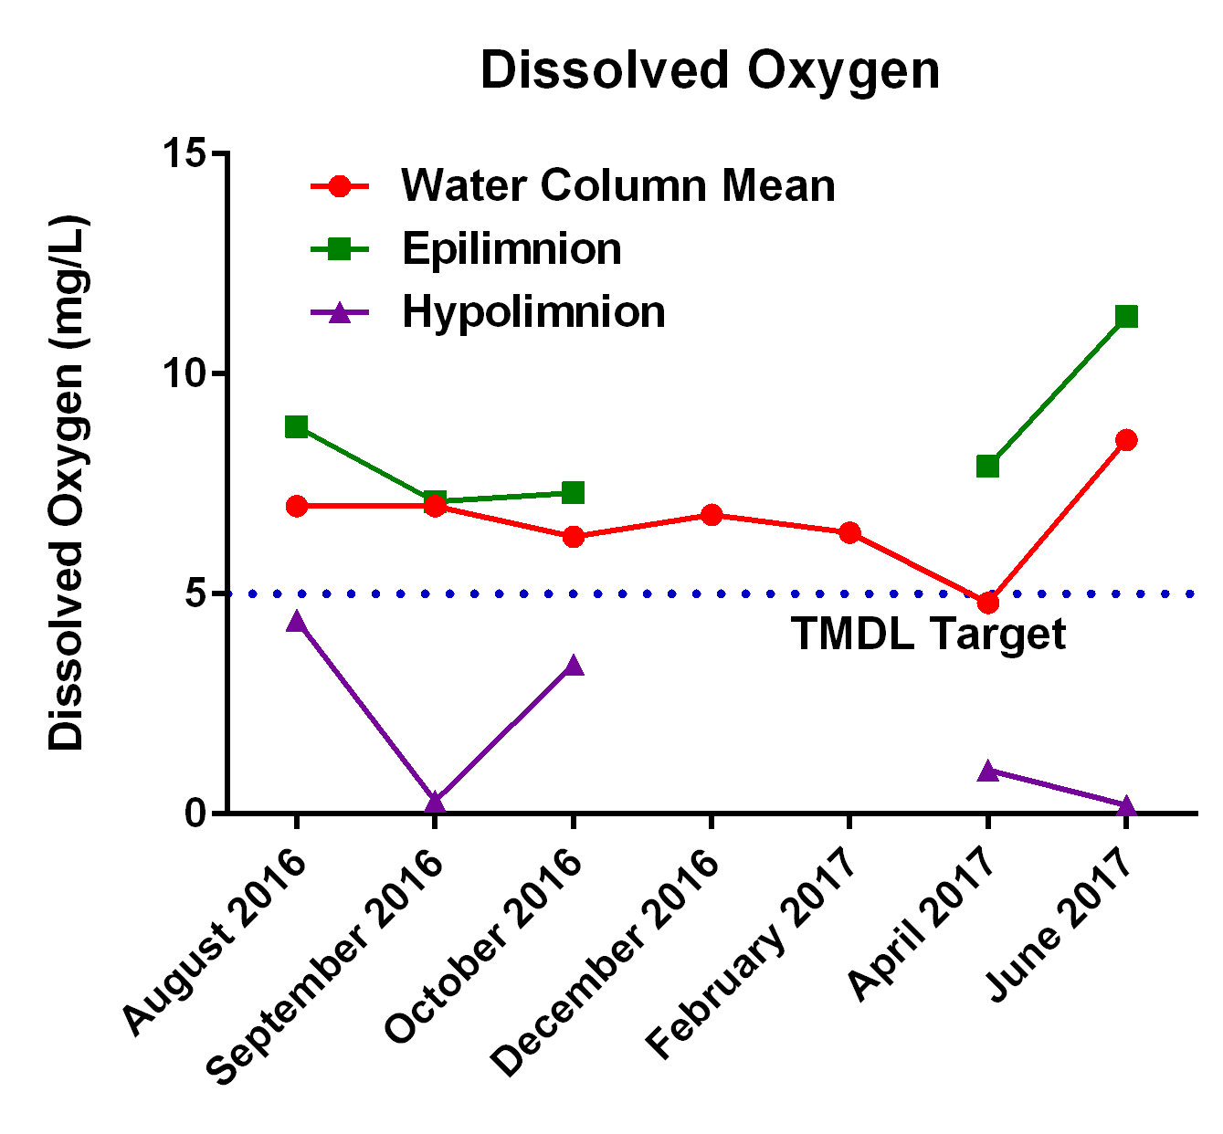
Canyon Lake Dissolved Oxygen – East Basin Epilimnion vs. Hypolimnion 2016-2017
Mean of Sites CL09 & CL10
No stratification in Sept (CL10) & Dec/Feb (both)
Not sampled in July 2016

Slide 48
Dissolved Oxygen – Diurnal Variability

Slide 49
Lake Elsinore Dissolved Oxygen – Morning vs. Afternoon TMDL Compliance July 2015 to June 2017
Site | TMDL DO Target | Time of Measurement | # of Events | # Events in Compliance | Percent of Events in Compliance
LE01 | 2015 Water Column Mean | Morning | 14 | 9 | 64%
 |  | Afternoon | 13 | 10 | 77%
 | 2020 1m from Bottom | Morning | 14 | 6 | 43%
 |  | Afternoon | 13 | 5 | 38%
LE02 | 2015 Water Column Mean | Morning | 14 | 7 | 50%
 |  | Afternoon | 13 | 9 | 69%
 | 2020 1m from Bottom | Morning | 14 | 7 | 50%
 |  | Afternoon | 13 | 5 | 38%
LE03 | 2015 Water Column Mean | Morning | 14 | 9 | 64%
 |  | Afternoon | 14 | 10 | 71%
 | 2020 1m from Bottom | Morning | 14 | 7 | 50%
 |  | Afternoon | 14 | 7 | 50%

Slide 50
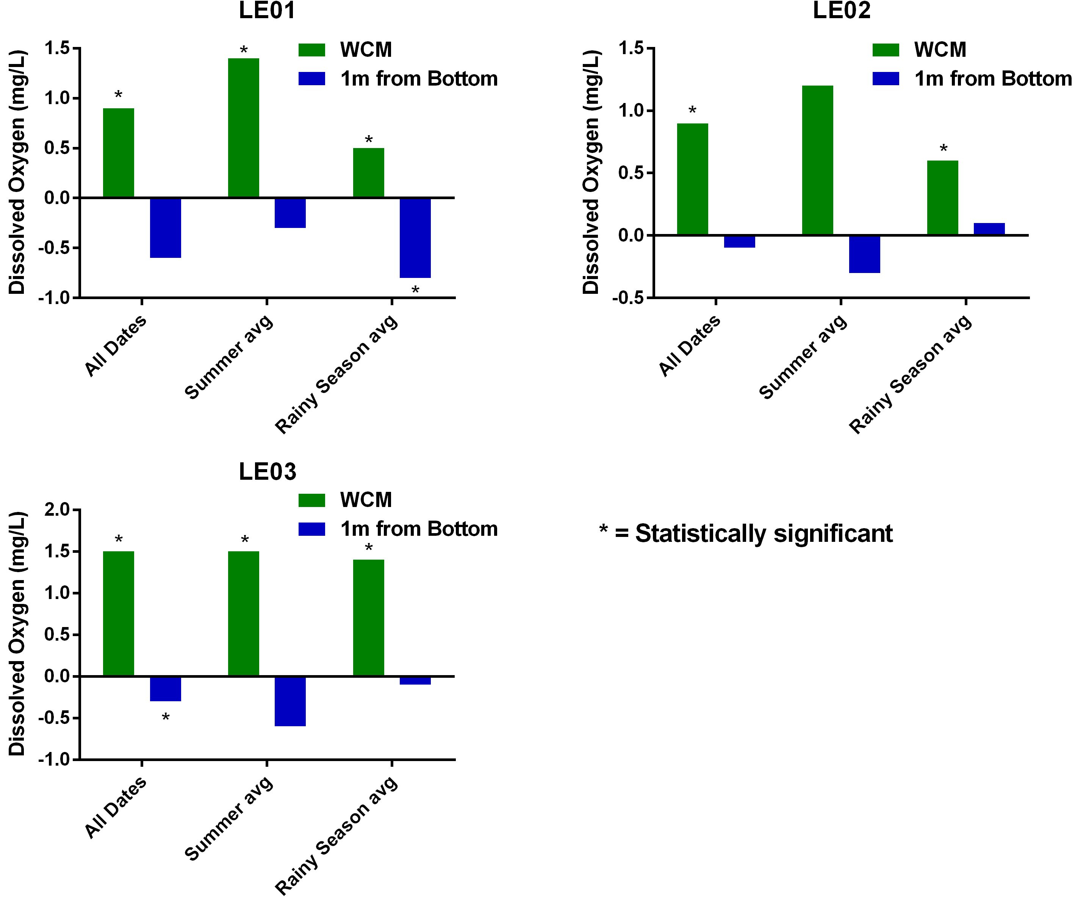
Lake Elsinore Dissolved Oxygen – Morning vs. Afternoon TMDL Compliance by Season July 2015 to June 2017
Plotting mean difference in Morning vs. Afternoon DO values
* = Statistically Significant Morning vs. Afternoon
Note: Positive values represent periods when DO increased from morning to afternoon, negative values indicate a decrease in DO from morning to afternoon

Slide 51
Canyon Lake Dissolved Oxygen – Morning vs. Afternoon TMDL Compliance July 2015 to June 2017
Site | TMDL DO Target | Time of Measurement | # of Events | # Events in Compliance | Percent of Events in Compliance
CL07 | 2015 Epilimnion | Morning | 11 | 10 | 91%
 |  | Afternoon | 9 | 9 | 100%
 | 2020 Hypolimnion | Morning | 11 | 0 | 0%
 |  | Afternoon | 9 | 0 | 0%
CL08 | 2015 Epilimnion | Morning | 11 | 11 | 100%
 |  | Afternoon | 9 | 9 | 100%
 | 2020 Hypolimnion | Morning | 11 | 1 | 9%
 |  | Afternoon | 9 | 2 | 22%
CL09 | 2015 Epilimnion | Morning | 11 | 11 | 100%
 |  | Afternoon | 9 | 9 | 100%
 | 2020 Hypolimnion | Morning | 11 | 2 | 18%
 |  | Afternoon | 9 | 1 | 11%
CL10 | 2015 Epilimnion | Morning | 8 | 8 | 100%
 |  | Afternoon | 8 | 8 | 100%
 | 2020 Hypolimnion | Morning | 7 | 3 | 43%
 |  | Afternoon | 8 | 5 | 63%
Note: Only events shown are those when thermal stratification was present at the time of monitoring.
No measurements were taken in the afternoon for October 2015 or September 2016 events.

Slide 52
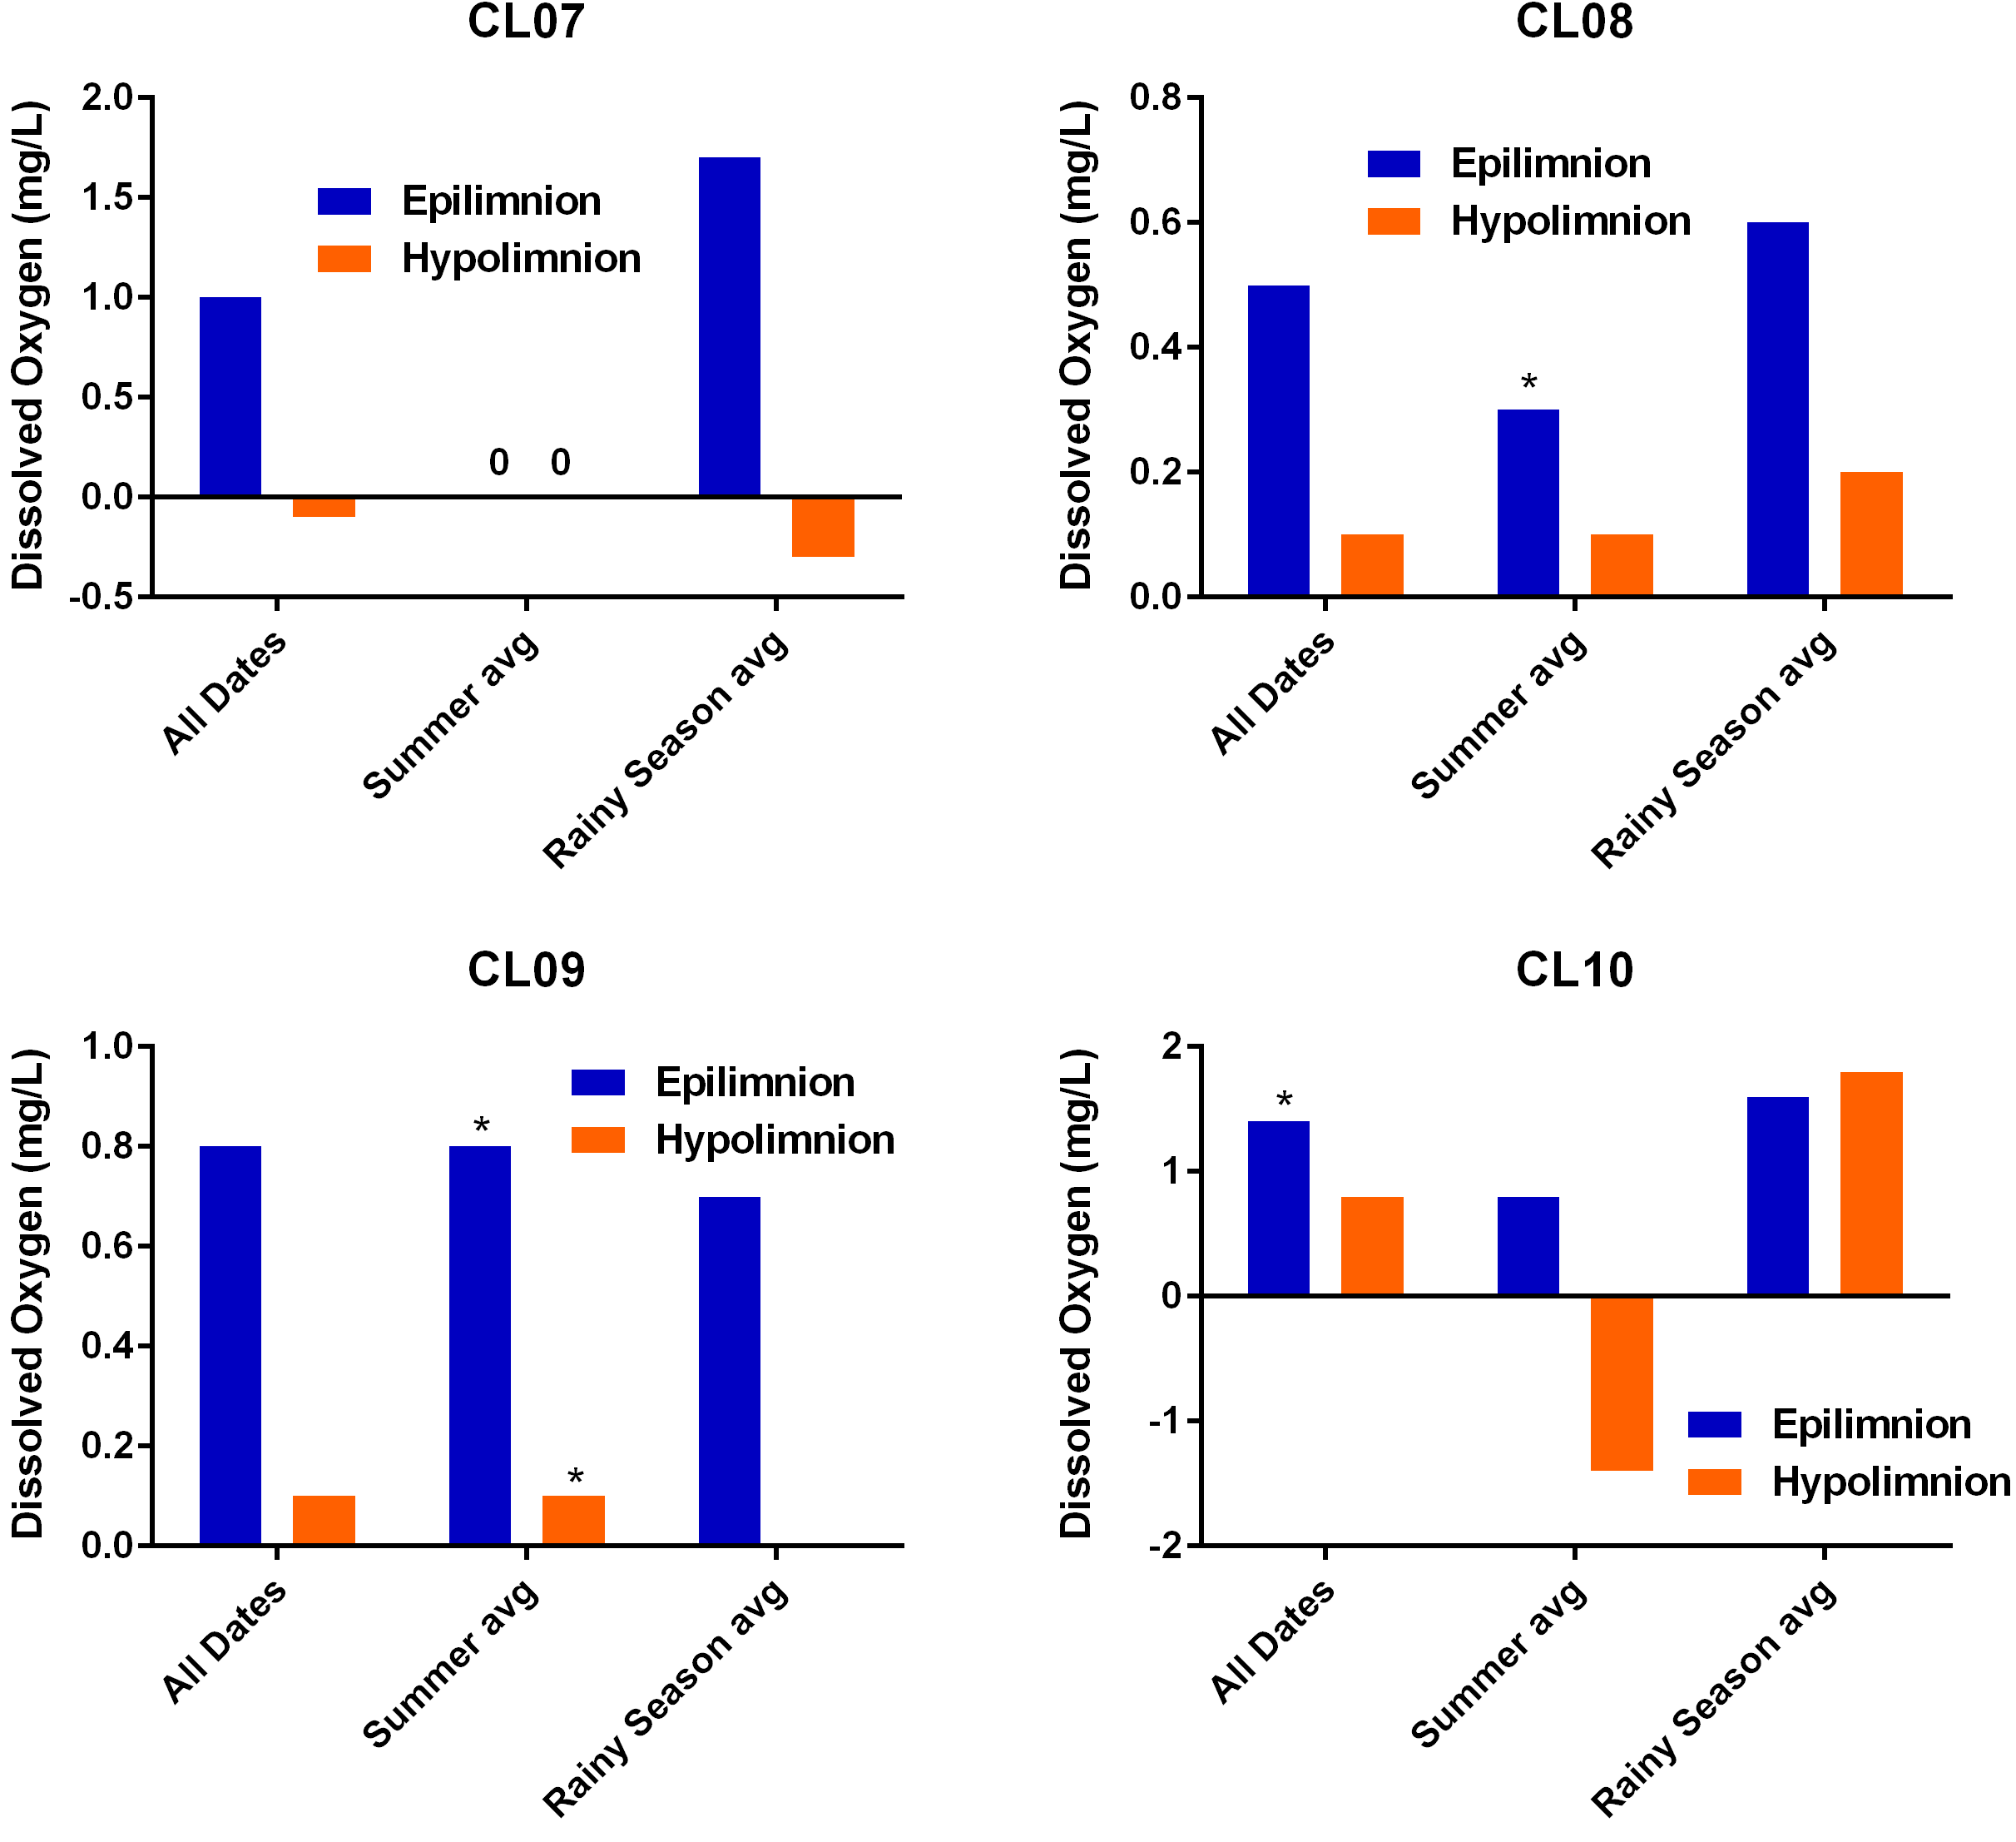
Canyon Lake Dissolved Oxygen – Morning vs. Afternoon TMDL Compliance by Season July 2015 to June 2017
Plotting mean difference in Morning vs. Afternoon DO values
* = Statistically Significant Morning vs. Afternoon
Note: Positive values represent periods when DO increased from morning to afternoon, negative values indicate a decrease in DO from morning to afternoon
No difference in mean DO was observed between morning and afternoon in epilimnion or hypolimnion at Site CL07 during summer periods

Slide 53
Lake Elsinore Dissolved Oxygen
Do In-Lake Sondes Represent Lake-wide Conditions?
Hand-held Profiles vs. In-lake Sondes July 2015 to June 2017
Data points represent individual 1-m depth readings
Hand-held meter readings were taken immediately adjacent to in-lake sondes with maximum 30-minute time difference

Slide 54
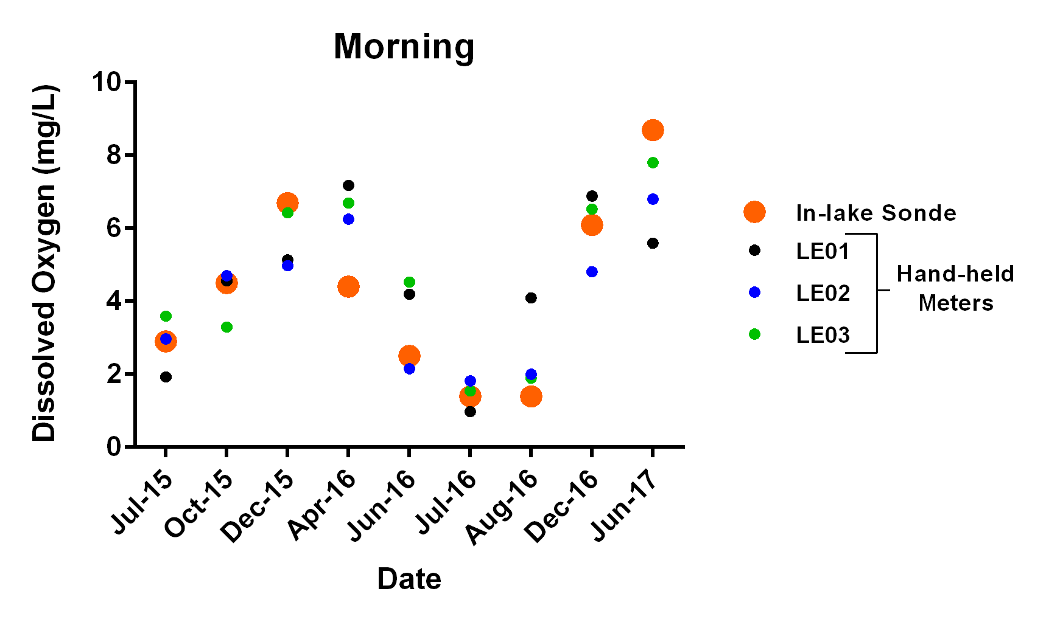
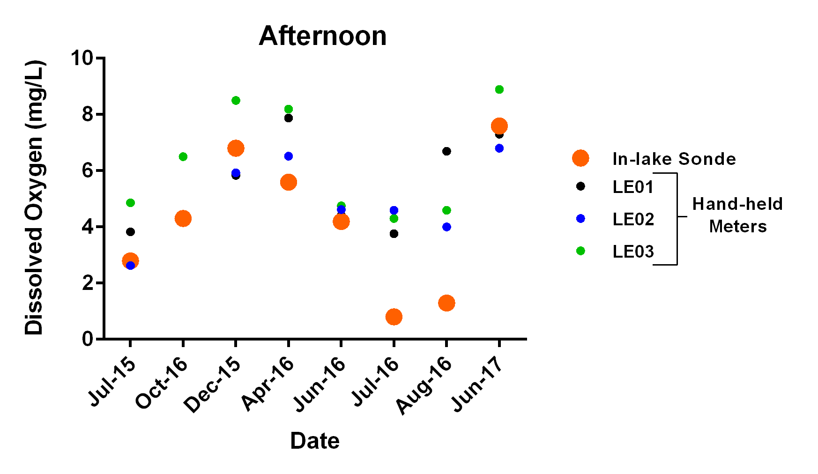
Lake Elsinore Dissolved Oxygen – July 2015 to June 2017 Do In-Lake Sondes Represent Lake-wide Conditions?
Grand Avenue Sonde
Data points represent water column means
Hand-held meter and In-lake sonde in general agreement
Hand-held meter and In-lake sonde not in agreement

Slide 55
Lake Elsinore and Canyon Lake TMDL Water Quality Monitoring Update – 2016-17 Summary
Cyanobacterial Toxin Monitoring

Slide 56
Lake Elsinore Cyanotoxin Bloom
Water Samples 2016-2017

Slide 57
Lake Elsinore Cyanotoxin Bloom
Scum Samples 2016-2017

Slide 58
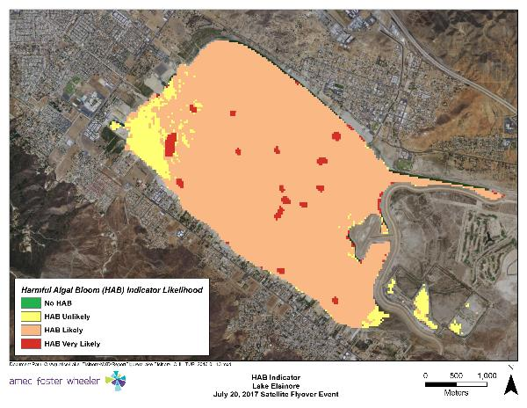
Satellite Imagery Cyanotoxin Indicator – July 2017

Slide 59
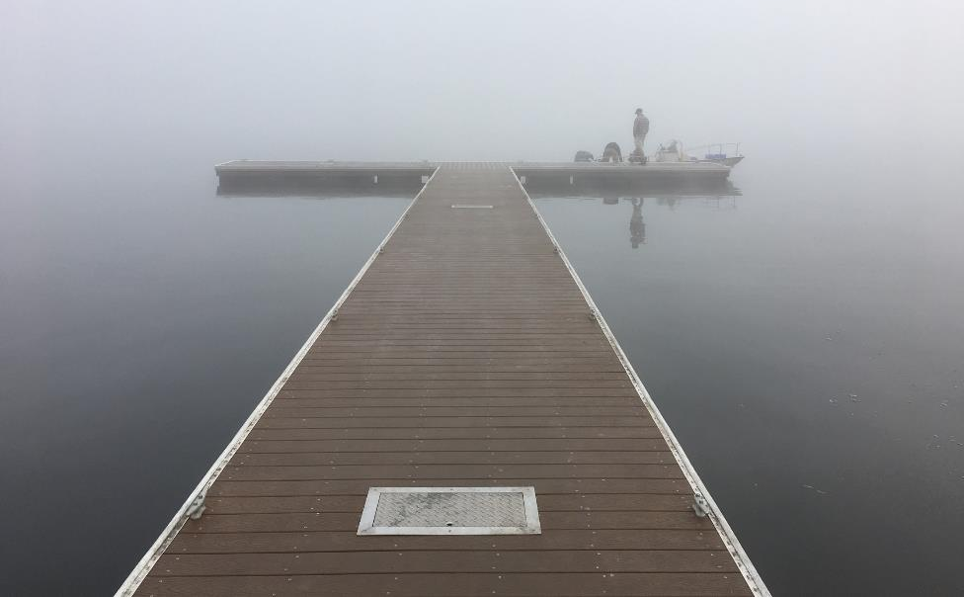
Questions?

Slide 60
Back Up Slides

Slide 61
Cyanotoxin Concentrations– Lake Elsinore 2016-2017
Analytes | Microcystin Concentration (ug/L)
 | July 27 | Aug 1 | Aug 9 | Aug 18 | Aug 29 | Sept 19 | Oct 5 | Dec 8 | Feb 2 | Apr 7 | Jun 2
La Laguna Boat Ramp - Scum | 26500 |  | 19450 | 382 | 26000 | 23425 | 6600 | 201
La Laguna Boat Ramp - Surface Water | 5.36 |  | 11.6 | 77.5 | 5950 | 27.5 | 19.4 |  | 2.35 | 4.19
Center Lake - Depth Integrated Water |  | 5.3 | 8.9 | 7.2 | 30.6 | 13.5 | 20 |  |  |  | 1.4
Center Lake - Scum |  | 93500 |  |  |  | 3110 | 70 | 114
Center Lake - Surface Water |  |  | 161 | 10.6 | 15.3 |  |  |  | 1.59 | 3.87 | 1.2
Elm Grove Beach - Surface Water |  |  | 326 | 163 | 172 | 10900 | 35 | 56 | 2.79 | 2.7
California CyanoHAB Trigger Levels for Human Health (ug/L)
Toxin | Caution – Action Trigger | Warning – Tier 1 | Danger – Tier 2
Microcystin | 0.8 | 6.0 | 20

